Slide 1
CONTRIBUTIONS FROM O.R. PRACTICE TO A USEFUL THEORY OF PUBLIC POLICY
John Friend, [IOR emeritus *]
jfriend@btinternet.com
South Yorkshire, UK
* Institute for Operational Research, 1964 to 1986
[a joint enterprise of OR Society & Tavistock Institute of Human Relations]
Former programme leader and chair
thereafter working “independently”, with various academic links
OR Society Conference, Royal Holloway, September 2014
Notes:
This talk comes from a recent ORS charitable project
Short – but a long back story
& project future-facing
How I describe myself –
IOR “emeritus” – in my 80’s
“independent” consultant
yet project dependent
retirement? – family pressures!
first 14 slides – 30 minutes

Slide 2
O.R. AS A SOURCE OF INNOVATION IN DESIGNING PUBLIC POLICIES
O.R. CAN OFFER A LEADING ROLE IN INTRODUCING INNOVATIVE PROCESSES FOR DESIGNING PUBLIC POLICIES
- in addition to OR’s analytical support role
claim is backed by a long track record of innovation & influence, initially in the UK - then in several other countries
yet there is less awareness of this record in the OR community than within [some] public policy professions
evidence of significant inputs to a useful theory of public policy [notably via ESRC-funded IOR research projects 1968-82]
NOW:
an OR Society charitable project has explored the relevance of this legacy to the future influence of OR on public policy
a recent joint event of the OR Society with the government policy profession has attracted wider civil service interest
a new OR Society Special Interest Group for public policy design now offers opportunities to build on this momentum
Notes:
A bold claim for OR!
but need to learn from others
Potential to offer useful theory [to all these others]
My brief transitional project
Direct outcomes include:
joint event with civil service
now a new SIG for public policy with a design focus

Slide 3
SOME DISTINCTIVE CHALLENGES IN PUBLIC POLICY
THE WORLD OF PUBLIC POLICY is distinguished from the world of business strategy by:
[1] the multiple sources of PUBLIC ACCOUNTABILITY that vie for influence on decisions, with contending MODELS OF EQUITY; and
[2] ] the FABRIC OF INTERDEPENDENCE that results from the structure of systemic relationships among governmental organisations.
CHALLENGES OF VARIETY: matching the variety of decision situations – policy is generic [requisite variety in spades – e.g. Universal Credit]
CHALLENGES OF POLICY DESIGN: [a] Expression of policy options as choices not only of direction but also of specificity; [b] Expect public challenges on grounds of compatibility with related policies.
CHALLENGES OF POLICY EROSION: Wherever multiple policy sources impinge on the same decision situation, a state of policy stress can arise - contributing to a process of policy erosion through time.
CHALLENGES OF APPROPRIATE ENGAGEMENT. Expectations of engagement in policy processes by representatives of varied public interests - raising choices of level, timing, process design .
Notes:
Characteristics of public policy
[vs. business strategy]
multiple sources of accountability
policies as a generic influence
challenges of requisite variety
challenges of policy design:
specificity & compatibility
- policy stress & erosion
– the policy agent’s perspective
- appropriate engagement of stakeholders in policy design

Slide 4
A STORY OF ENGAGEMENT, EXPERIMENT & INFLUENCE
A STARTING POINT: I joined the new IOR in 1964, [age 33] with a maths degree then 10 years of analytical roles in manufacturing & transport.
A CULTURE SHOCK: As a team member on one of IOR’s 3 pioneer projects, I worked with social scientists in trying to understand diffuse decision processes, leading to [painful] adjustment in research focus & methods.
EXPERIMENTATION: From 1970, we designed action research projects with local authority planning teams to test new planning methods, aiming for stepwise progress in tackling linked areas of decision & of uncertainty.
FACILITATION : evolution of a style of facilitating group planning processes, using graphical media on walls to build a shared view of problem structure & to shape incremental progress towards commitment.
RESEARCH: exploring inter-organisational decision processes in public policy via ESRC projects alongside government contracts
DIFFUSION of innovations via planning workshops; short courses; books; development of interactive software [as an optional alternative to paper on walls] – useful for consultants & intimate planning groups.
Notes:
A succession of transitions –
one OR veteran’s career story
a naive start
exposed to diffuse processes
innovation via action research
from analyst to facilitator
inter-organisational research
international diffusion

Slide 5
CONTRIBUTIONS TO PRACTICE IN PUBLIC POLICY
a view of planning as choosing strategically through time
a view of uncertainty [multi-source] as a key process driver
UE – uncertainties relating to Evidence
UV – uncertainties relating to guiding Values
UR – uncertainties relating to choices on Related agendas
a framework for agreeing on incremental progress
[the progress package – balancing uncertainty vs. urgency]
a balanced suite of graphical tools for structuring:
problems expressed as interconnected areas of decision
progress over time in addressing decisions + uncertainties
later - tools for design of engagement in extensive projects
variable levels/frequencies of engagement [according to role]
designs for synthesis of political and technical inputs
designs for staged progression towards agreed outputs
Notes:
A distinctive process view of planning
Decisions + uncertainty as drivers
3 types of uncertainty source
A framework for staged progress
Graphical communication tools for structuring problems & progress
Designs for engagement
- Technical/political balance

Slide 6
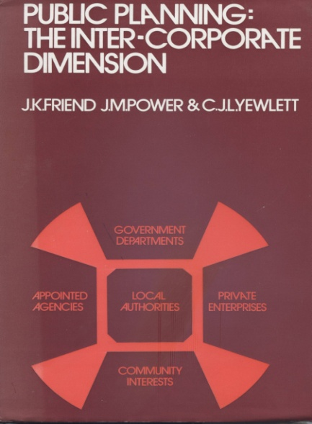
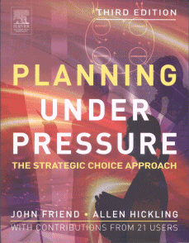
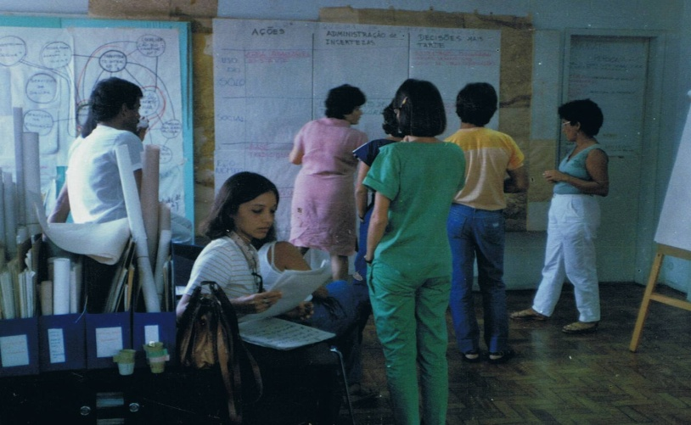
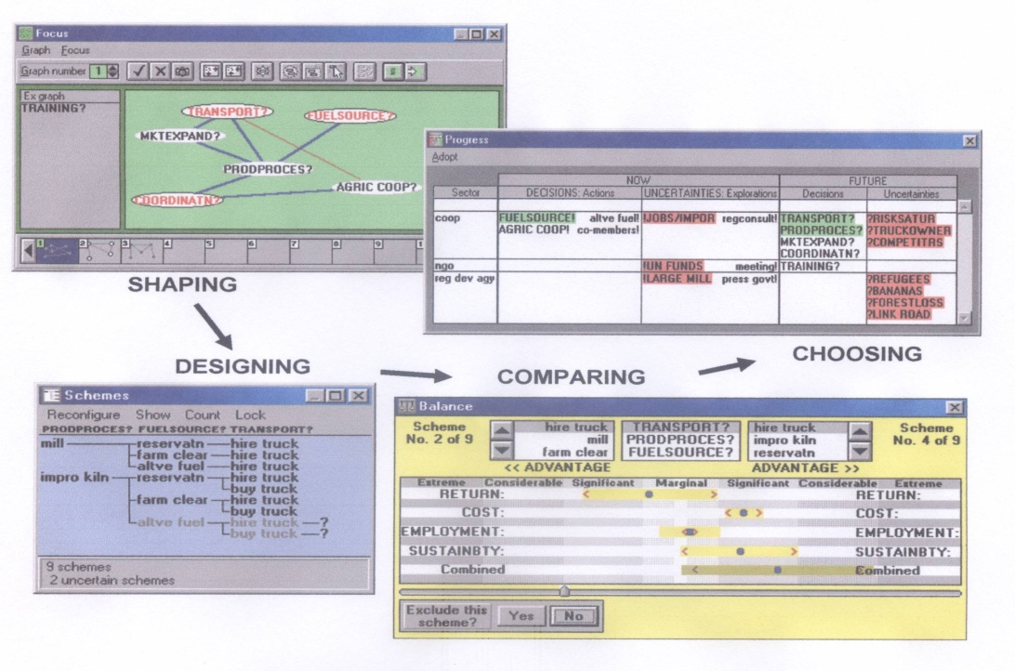
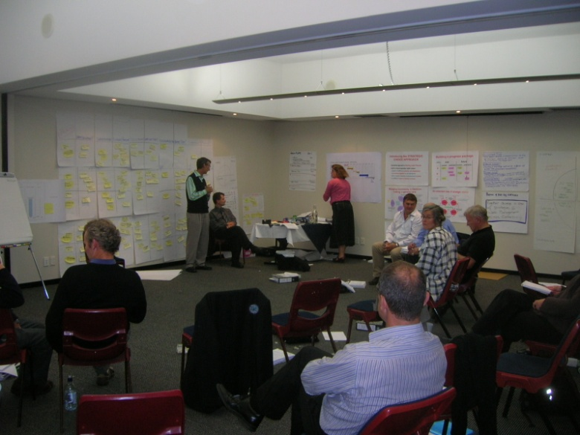
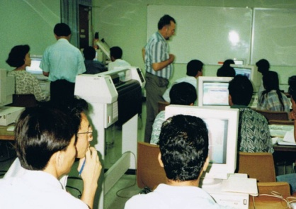
1984 NE Brazil offshore island policies
SOME PARALLEL CHANNELS OF DIFFUSION
WORKSHOPS in UK and abroad
BOOKS published from 1969 onwards
1974: reprinted Routledge 2001
1987: 3rd English language edition
2004 Routledge: [translations into Japanese 1991 , Spanish 2002]
2009 NZ regional water strategy
SOFTWARE 1990 – 2011
used in 36 countries
1995 STRAD class at
Asian Institute of Technology, Thailand
Notes:
Books [& articles] + translations
first policy book – 1969 [local government focus]
Workshops – many, with varied stories: Brazil 1984 v NZ 2009
Software - global diffusion:
current gap & opportunity
Training: immersive designs

Slide 7
A TOOLKIT FOR COMMUNICATION IN STRATEGIC CHOICE
Example of a decision graph
WHO? | Actions Now! | Explore Now! | Future choices? | Future perplexities?
A
B
C
Example of a progress package
When?
What?
Who?
Do this!
Investigate!
Explore how?
Where?
?
Do that!
Do what?
Explore how?
focus
?
Consult!
transparent
methods of structuring PROBLEMS
transparent
methods of structuring PROGRESS
ISSUES
progress package
DECISIONS
process tracking chart
process tracking chart
SHAPING
CHOOSING
problem focus
facilitation
preferences & uncertainties
DESIGNING
COMPARING
more transparent tools for COMBINATORIAL DESIGN [within a variable focus]
more transparent tools for MULTI-CRITERIA COMPARISON [exposing sources of uncertainty]
range of possible strategies
Notes:
The [current] SCA toolkit:
a process perspective [dynamic]
Main focus: structuring:
problems [as decision areas]
& progress through time
- also designing & comparing tools linking to more established OR methods

Slide 8
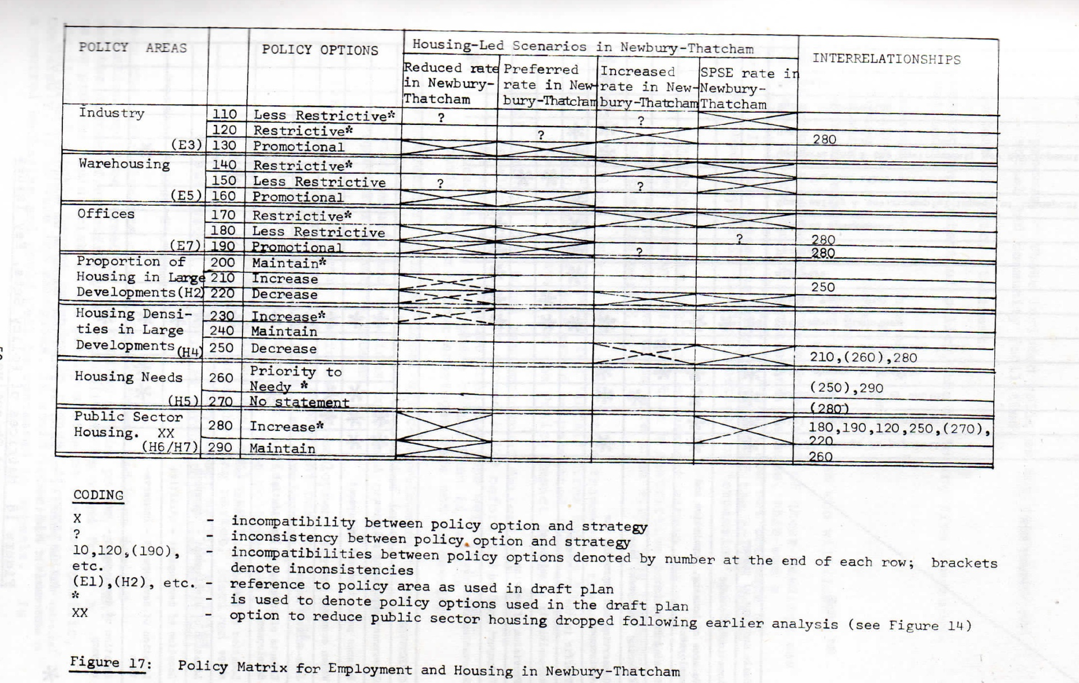
EVALUATING POLICY OPTIONS WITH ALTERNATIVE SCENARIOS
From: Strategic Choice in Practice. 1976 . Dept. of Geography, University of Reading. Bather, Williams & Sutton.
Figure 17. Policy matrix for employment & housing in Newbury-Thatcham
[for West Berkshire Structure Plan]
Notes:
Example of an early adaptation to policy design – Berkshire 1976
Action research – OR + planners
Matrix of policies x growth strategies
Semantic policy options as basis for design of dialogue officers/politicians
[also in other English counties]
2009 New Zealand - water policy
created an “evaluation space”

Slide 9
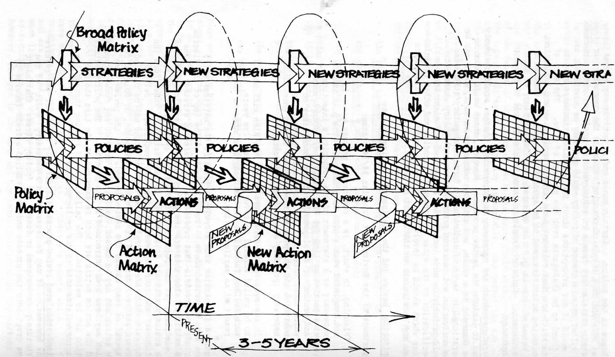
CONTINUITY IN DESIGING POLICIES AND ACTIONS
From: Strategic Choice in Practice. 1976 Dept. of Geography, University of Reading. Bather, Williams & Sutton.
Figure 18. The Continuous Planning Process. Design & artwork by Allen Hickling
Notes:
From the same 1976 report
- A version of master process diagram [Allen Hickling, architect]
[n.b. no use of CAD software!]
Allen has now applied operational versions of this thinking widely in Europe – see later chapters of PuP [Friend & Hickling, Routledge 2004]. Has led to practical designs for policy engagement [PuP Fig102]

Slide 10
DEVELOPING USEFUL THEORY
IOR’s initial thrust: OR + social science approach to public policy
from 1960’s, debates in US & Europe on ideas for promoting policy science: journals, academic schools, government units
IOR early links to policy schools: Birmingham, Australia, Europe
ESRC projects on inter-organisational planning 1968-82
contributions to discussions in academic symposia in Europe & North America 1975 to 1985 - initiated via IIM in Berlin
Policy themes from IOR project work attracted growing attention:
- policy design challenges – option design, compatibility
- mapping of policy systems & flexible decision networks
- policy dynamics – dual perspectives: makers & agents
- policy stress & policy erosion
- asymmetrical partnerships
Notes:
Now for development of theory:
Social science as early IOR influence
from 1960’s – public debates on recognition of policy science
But is there any fresh content?
ESRC projects from 1968 to 1982
focus: inter-organisational policy
Mapping networks, policy dynamics

Slide 11
POLICY DYNAMICS - DUAL PERSPECTIVES
THE VIEW FROM ABOVE
POLICY SOURCE A
POLICY SOURCE A
POLICY SOURCE B
POLICY SOURCE C
Implementation
?
guidelines
guidelines
Interference
?
Policy
Agent X
Policy Agent Y
Policy agent Z
Policy agent X
THE VIEW FROM BELOW
State of POLICY STRESS
UPWARD PRESSURE FOR POLICY CHANGE
Process of POLICY EROSION
Notes:
Wide evidence of dual perspectives
Policy makers v. Policy agents
Implementation vs. interference
Local perceptions of policy stress
Upward pressures for policy change
Gradual process of policy erosion
- can lead to toothless policies
so to pressures for change

Slide 12
DECISION-MAKING IN AN ASYMMETRICAL PARTNERSHIP
(a): SYMETRICAL PARTNERSHIP (b): ASYMMETRICAL PARTNERSHIP
locus of representation in this partnership
locus of policy accountability in this organisation
Within a partnership designed to promote collaboration among policy systems , the opportunities for progress towards agreement depend on the organisational distance between the locus of representation in the partnership of each policy system and its locus of policy accountability. This tends to be more variable in the case of an asymmetrical partnership
Notes:
Politics of partnerships
- symmetrical vs. asymmetrical
early IOR view “petal diagram”
led to a less balanced view
remote partners constrained by organisational distance between level of representation & policy source

Slide 13
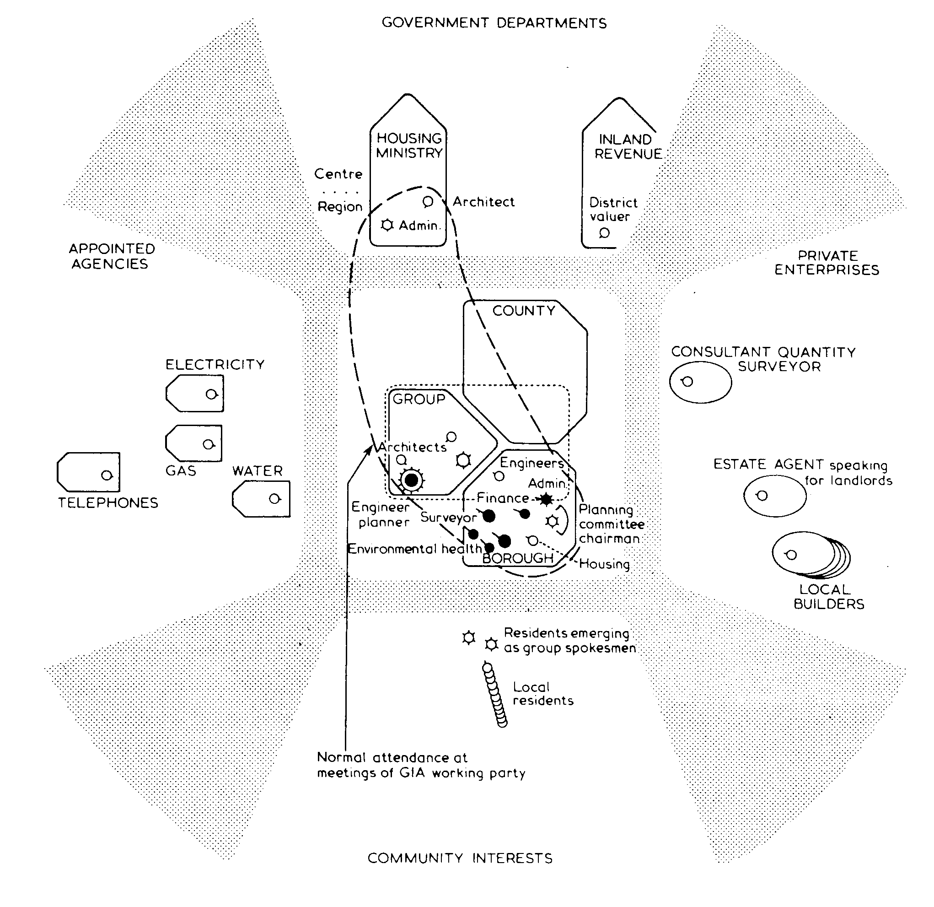
MAPPING RELATIONS WITHIN PUBLIC POLICY SPACES
In terms of linked POLICY SYSTEMS & more transient DECISION NETWORKS
GOVERNENT
DEPARTMENTS
fan chart for:
Tony
Group Engineer
Droitwich Borough Council
local road decisions
1972
APPOINTED
AGENCIES
PRIVATE
ENTERPRISES
COMMUNITY
INTERESTS
From Public Planning: the Inter-corporate dimension. Friend, Power & Yewlett
Tavistock 1974, reprinted Routledge 2001 Fig 42 p182.
Q. What advances in such mapping methods can be made through 21st century information systems technologies?
Notes:
ESRC Droitwich project [1969-74] tried to capture complexity via
fan charts all on a common base
Interlinked policy systems with many superimposed decision networks as overlays
How to plot institutions/individuals?
Scope now for redesign using GIS type technology

Slide 14
TAKING STOCK – September 2014
INFLUENCE of this legacy is now quite WIDE – but scattered
communities other than OR – PUBLIC PLANNING, POLICY
champions widely dispersed – Europe, developing world
  spread across university schools, consultancies, governments
  STIMULUS from academic links – but disciplinary barriers can inhibit
  Insights from other LANGUAGES [& other world views]
  Some CROSS-FERTILISATION with other sources of innovation
  Increasing RESEARCH DEFICIT due to consultancy THRUST
  ORS Charitable project 2013-14 – focus on IOR legacy & implications for investing in appropriate skills, technology, research ...
  Current evidence of rising policy interest in UK civil service
  Occasional news of unexpected influences [via software – Peru, Iran]
  Two current challenges: CONSOLIDATION of core ideas & methods
  REJUVENATION of human resource
  as gateways to future contributions to policy practice & theory
Notes:
Where are we now?
Wide influence outside OR & UK
Varied academic & practice links
Current research deficit
Recent policy priorities: UK + other
2 challenges: consolidation
rejuvenation
Case for investing in skills/technology/research

Slide 15
directions for investment in APPROPRIATE SKILLS
skills for structuring not only PROBLEMS – also PROGRESS & ENGAGEMENT
skills of INTERACTION & INTERROGATION as prelude to [joint] structuring
facilitation skill - balancing INTERACTION, METHODS, PROGRESS [IMP]
ANALYTICAL SKILLS vital in designing tools – then TRANS-ANALYTIC potential
however CONFIDENT FACILITATORS include many with different backgrounds
CURRENTLY:
LIMITED CLUSTERS in UK with relevant skills [and TRANS-ANALYTIC potential] - can be brought out via a mix of apprenticeship & short courses
dispersed experience in designing IMMERSIVE/INTERACTIVE SHORT COURSES – proven potential [as taster] of MUTUAL CONSULTING WORKSHOPS
recent designs for STAGED COURSES IN STAKEHOLDER ENGAGEMENT
FUTURE:
GORS & DSTL OR as promising reservoirs of future policy design skills
value of learning alongside EXPERIENCED PUBLIC MANAGERS [joint courses?]
MASTERS COURSES [full or part-time] as a design model for deeper learning
value of JOINT COURSE DESIGN by OR staff with public policy practitioners
DESIGN OPTIONS to be explored for course delivery, sponsorship, recruitment
Notes:
Appropriate skills? Structuring
+ interaction “trans-analytic”
Limited reservoirs in UK + abroad
Experience in designing courses
GORS + Dstl OR as growth points
new interfaces with experienced
policy people - Masters courses?

Slide 16
directions for investment in APPROPRIATE TECHNOLOGY
problem structuring tools [++] as APPROPRIATE TECHNOLOGY [intermediate]
technology to enrich COMMUNICATION among people with diverse inputs
varied origins of technologies – structuring DECISIONS VS. SYSTEMS [& other]
Strategic Choice toolkit: PUBLIC POLICY origins, DECISION DYNAMICS focus
Well-tested DESIGNS for SC workshops – graphics, flipcharts, broad tip pens
SOFTWARE now developed as an alternative [for consultants & close groups]
technology to sustain GLOBAL EXCHANGE NETWORKS [boosted by the internet]
FUTURE:
21st century now bringing wide opportunities for adaptation to NEW MEDIA
value of designing a global exchange framework with a POLICY DESIGN focus
dispersed nodes to service a MULTILINGUAL communication network
offer of access to PROCESS SUPPORT SOFTWARE to energise networks
design of SUBSIDISED ACCESS for students & other under-resourced groups
quick PILOT PROJECT to upgrade current software package with pioneer users
CURRENTLY:
Notes:
Technology? intermediate - for communication about structures
SCA emphases is on
public policy & decision dynamics
Workshop design: wide experience
Software as option [1990 – 2011]
Future? New media, global network investment. + value of a quick pilot with software users

Slide 17
directions for investment in APPROPRIATE RESEARCH
value of RESEARCH SPONSORSHIP in fuelling early innovation in IOR school
role of a RESEARCH COUNCIL [ESRC] in funding inter-agency research 1968-82
OR SOCIETY history of closer research links with EPSRC than ESRC
2004 joint ORS/EPSRC/ESRC REVIEW but EPSRC [only] supports consortium
CURRENTLY:
POTENTIAL PARTNERS in university schools of planning, policy, government
scope for EUROPEAN RESEARCH FUNDING with partners in e.g. NL, SE, IT
FUTURE:
value of EVALUATION STUDIES into impacts of major policy projects UK, EU
opportunities to design NEW RESEARCH TOOLS drawing on past ESRC work
  - for exploring programme influences on & from project engagements
  - for mapping structural & other relations in public policy arenas
international projects in important policy areas – eg WATER POLICY
involvement of OR Society [E&RC] in research design & co-ordination
value of engaging GORS & policy professionals in research proposal design
Notes:
Research sponsors vital:
ESRC as initial gateway?
Partners in academic schools [OR + other], government links [UK +]
Themes: workshop evaluation
water policy as big issue?
extending research tools
++++

Slide 18
DESIGNING A WAY FORWARD FROM 2014
WHO DRIVES/SPONSORS THESE INITIATIVES?
OR Society Public Policy SIG?
Dedicated committee or subgroup with close SIG linkage?
UK Government [GORS, policy profession .., digital service..?]
Process consultants – with European focus?
University teams [multi-disciplinary with OR + policy core]?
HOW SOON? Start dates, end dates, review horizons?
what linkage to electoral horizons 2015?
INTERFACES? political, technical, accountable, etc. channels?
RESOURCING? national, European, global, foundations?
+ outline designs for later extensions in global momentum
Notes:
Challenges of action planning
OR Society Public Policy SIG as
a bridge public & policy in UK
- Timing & logistic questions
- Resourcing questions
Strategy for expanding? international linkage
- Europe & global

Slide 19
STARTING TO STRUCTURE THE OPPORTUNITY SPACE
GUIDANCE
ARRANGEMENT?
UK government
OR Society
Joint
RESERVOIR OF FUTURE SKILLS?
GORS intakes
mature doctoral
consultants
PROGRAMME
SPONSORS?
UK government
Europe
other
Additional decision areas?
Alter phrasing?
Assess relative importance?
Assess relative urgency?
Alter or add options?
Add mixed options?
Insert decision links?
Select a focus?
Agree comparison criteria?
Selective pair comparisons?
Review uncertainty sources? [evidential/political/structural]
WHO DEVELOPS SKILLS?
government unit
academic OR
academic policy
process consultants
GLOBAL
INTERCHANGE SERVICE?
UK initiated.
Euro initiated
BRIC initiated
TECHNOLOGY
INVESTMENT?
social enterprise UK
commercial UK
governmental UK
BRIC
RESEARCH INVESTMENT?
Research council
Europe
foundations
Notes:
Outline design for an initial workshop session
[during PP SIG in November?]
Examples of [some] decision areas
Review choices, options, criteria ..
Aim for a 1st progress package
Follow up with further structuring in [various] wider groupings

Slide 20
RANGE OF SOURCES/RESOURCES ACCESSIBLE TO FUTURE INNOVATORS
Publications – books, translations, papers ...
Other accessible documents * [+ archives]
Software – STRAD [+ cases] & potential successors
Learning materials – course notes, case examples
Websites : OR Society [* IOR legacy section] also www.stradspan.com + successor[s]
Accounts of applications – various [newer] media
Active champions – in UK, Europe, elsewhere
Accessible veterans – IOR & associates UK, EU, ..
OR Society – Special Interest Group[s] [PP, PSM, ..]
Prospective partners – e.g. public policy schools, technology developers; international
*
Opportunities to dig deep – but who has the time?
Could be postgraduate students [joint supervision] and/or fast track civil service [dedicated team]
Notes:
There is much “data” to be mined
in various places & formats
- much of it in people’s heads
- also much now in electronic form
BUT who has the TIME to dig?
Postgrads? Dedicated govt.team?
SIG role in reviewing priorities?

Slide 21
AN ACTION PLAN 2014/15 [first draft!]
What? When? Who?
Revised SIG bid 29.09.14 RS
1st SIG meeting 17.11.14? RS, JF
Taster workshop for late 2014 RA, BH, FA? GORS [+ others?] [mutual consulting design]
technology workshop end 2014? govt + ORS ICT team?
1st software upgrade mid 2015 student [or DF]?
research planning early 2014 ORS E&RC + univs.
Further promotional events – e.g. European partners, international water policy, academic policy schools, ...
What RELEVANCE to Geoff Royston’s themes?
Analytics? : Behaviouralp : Complexityp : Designp : Evaluationp
Notes:
First draft for an action plan
[but should be a group process!]
Early horizons – ORS Board 8 Oct
1st SIG meeting [17 Nov?]
early taster workshops
early software upgrade
early research meeting
priority promotions eg water

